Slide 1


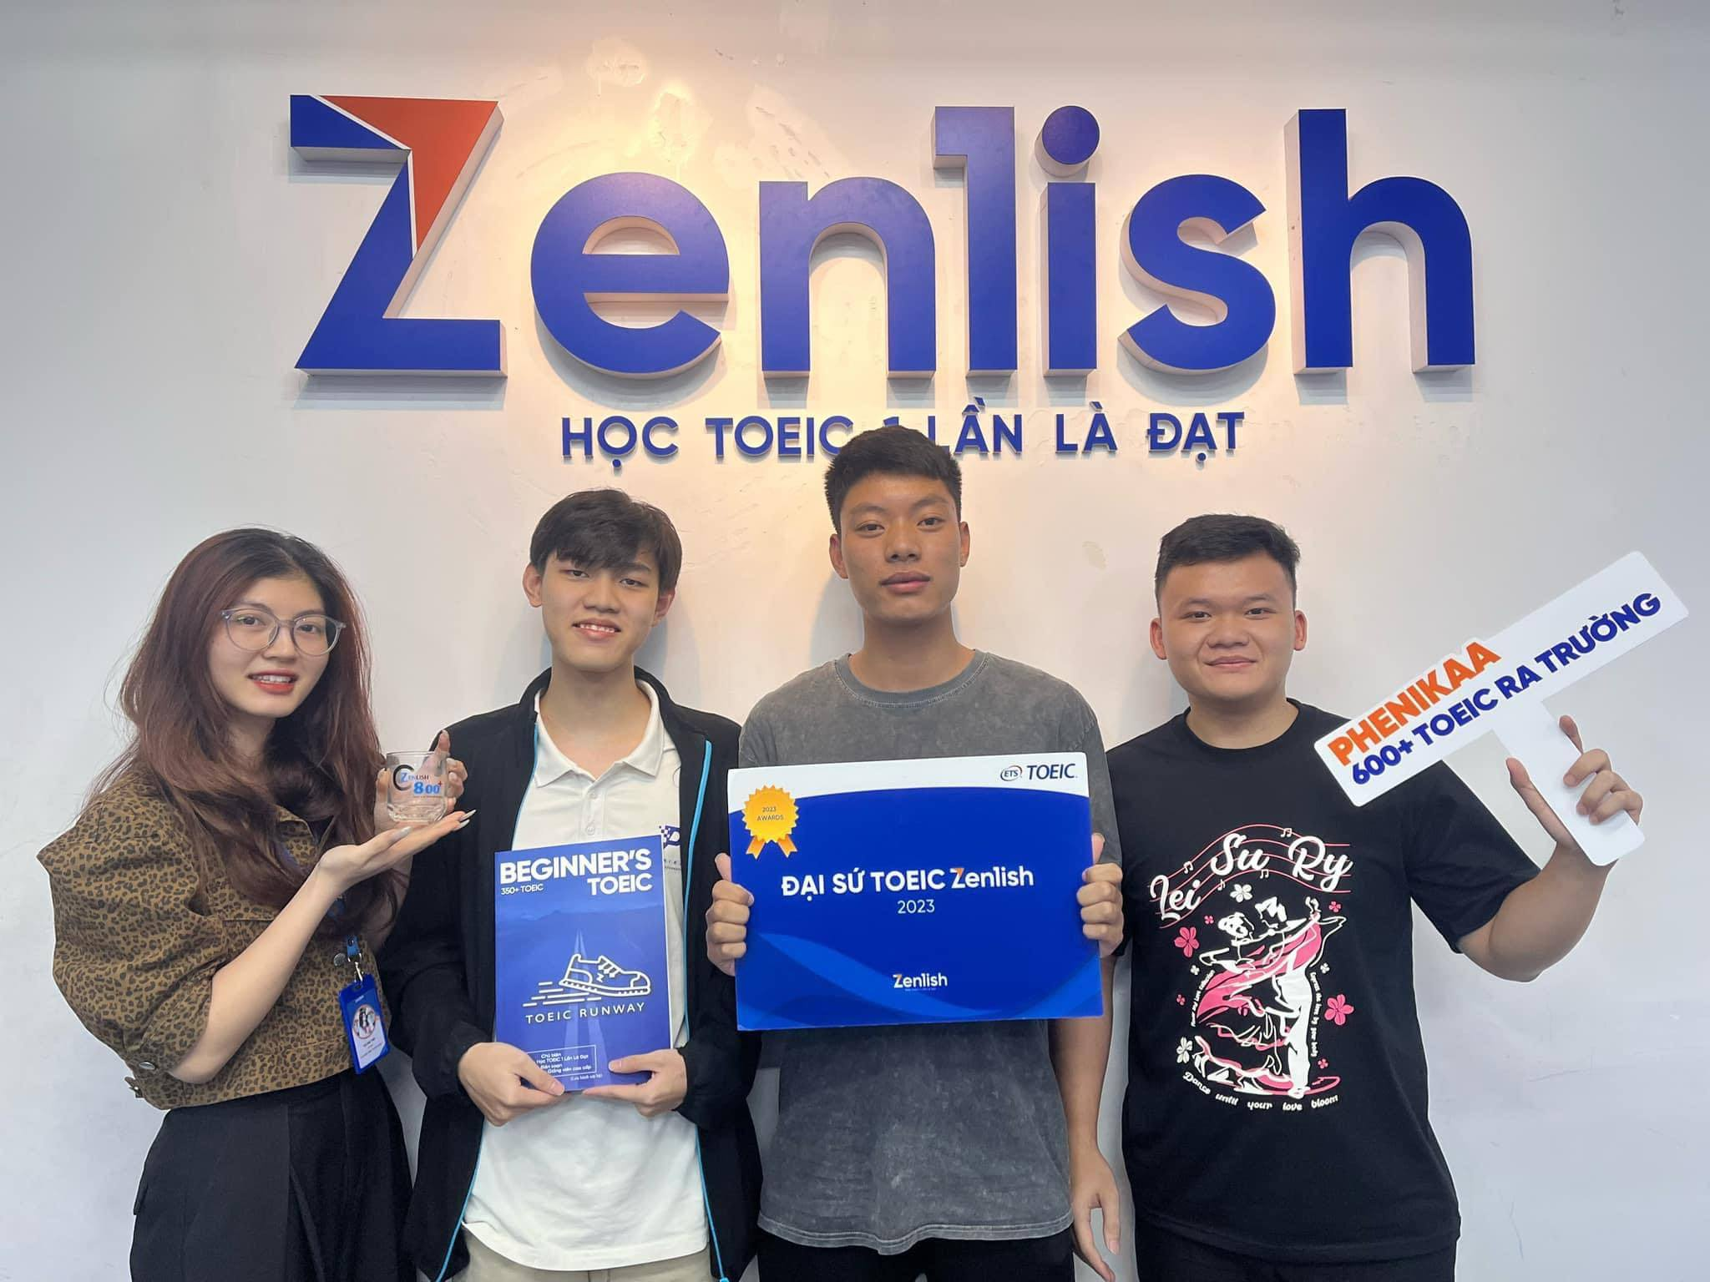
ZENLISH – HỌC TOEIC 1 LẦN LÀ ĐẠT
BEGINNER’S TOEIC
LESSON 2

Slide 2
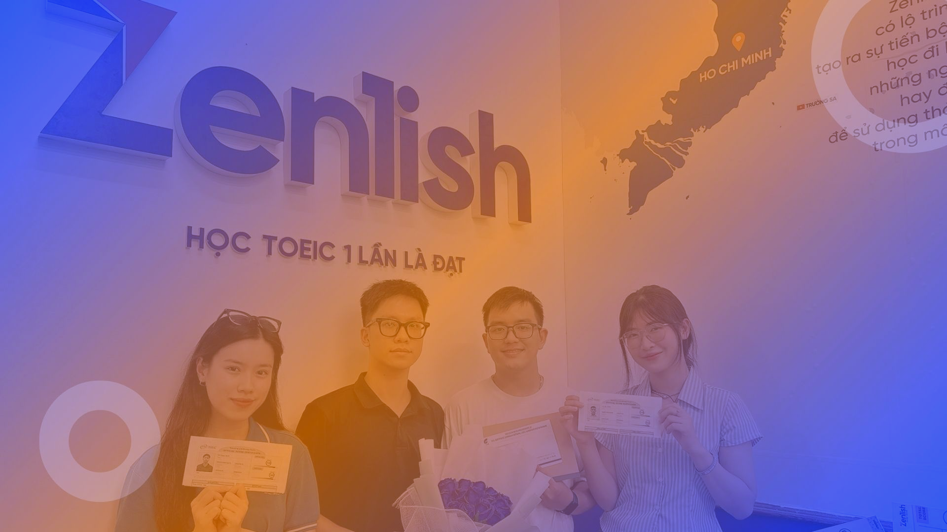

ZENLISH – HỌC TOEIC 1 LẦN LÀ ĐẠT
BEGINNER’S TOEIC
LESSON 2
CÂU HỎI WHO + WHERE + WHEN

Slide 3



NỘI DUNG BÀI HỌC
1
Ví dụ
Thực hành
3
2
Lý thuyết
Từ vựng
4

Slide 4


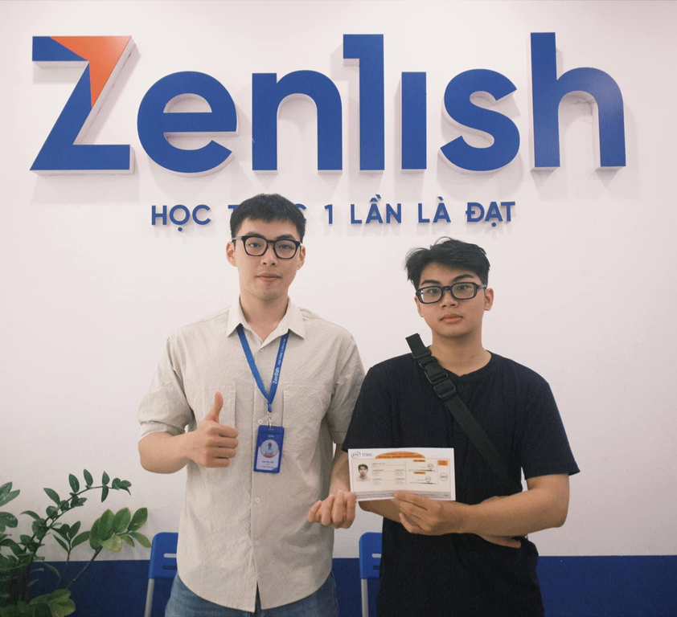


ZENLISH – HỌC TOEIC 1 LẦN LÀ ĐẠT
TOEIC LISTENING
PART 2 – WHO

Slide 5
NỘI DUNG BÀI HỌC
1
Ví dụ

Slide 6
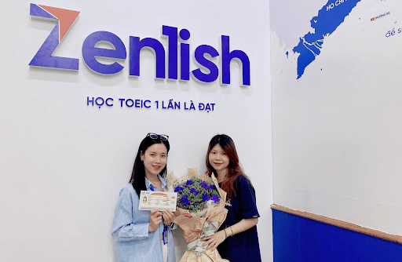

1
Who will replace Mr. Fernandez when he retires?
Who will replace Mr. Fernandez when he retires?
A. I heard that Maria Ortega will
A. I heard that Maria Ortega will
B. No. I’m not tired
Lưu ý:
Ở câu hỏi: Nghe 3 từ đầu tiên
Ở đáp án đúng: tên người, loại Yes/No
Lesson 1

Slide 7
2
Who is the woman in the black suit?
Who is the woman in the black suit?
A. She is the new marketing manager
A. She is the new marketing manager
B. No. I’m not tired
Lưu ý
Ở câu hỏi: Nghe 4 từ đầu tiên
Ở đáp án đúng: Nhóm từ chỉ chức vụ
Lesson 1

Slide 8
3
Who attended the awards ceremony?
Who attended the awards ceremony?
A. No one in my office
A. No one in my office
B. Attendance is mandatory
Lưu ý
Ở câu hỏi: Nghe 2 từ đầu tiên.
Ở đáp án đúng: Nhóm từ diễn tả chưa có ai, không có ai làm, tôi tự làm.
Lesson 1

Slide 9
4
Who conducts the quality control test on the brand-new products?
Who conducts the quality control test on the brand-new products?
A. Several people do
A. Several people do
B. The testing begins next week
Lưu ý
Ở câu hỏi: Nghe 2 từ đầu tiên.
Ở đáp án đúng: Một nhóm người, một team, một công ty làm việc đó
Lesson 1

Slide 10
NỘI DUNG BÀI HỌC
2
Lý thuyết

Slide 11
CÁCH NHẬN DIỆN ĐÁP ÁN ĐÚNG
Tên riêng
Chức vụ
Nhóm người
Câu gợi ý
Không ai /chưa ai
Loại Yes/No

Slide 12
NỘI DUNG BÀI HỌC
3
Thực hành

Slide 13

ZENLISH – HỌC TOEIC 1 LẦN LÀ ĐẠT
BEGINNER’S TOEIC
LESSON 2
WHO – TEST TACTIC

Slide 14


1
Who is Mr. Park meeting at the airport?
Who is Mr. Park meeting at the airport?
A. Inside the terminal
B. They called the taxi
C. A new client

Slide 15
2
Who booked the airline tickets?
Who booked the airline tickets?
A. Laura returned the book
B. Flights leave every hour
C. Someone in the Paris office

Slide 16
NỘI DUNG BÀI HỌC
4
Từ vựng

Slide 17
TỪ VỰNG
accountant applicant candidate assistant coworker colleague director keynote speaker | receptionist sales representative spokesperson supervisor vice president accounting department customer service department

Slide 18
TỪ VỰNG
accounting department customer service department finance department human resources (personnel department) maintenance department | maintenance department shipping department technical support team headquarters main office branch (office) catering company

Slide 19
ZENLISH – HỌC TOEIC 1 LẦN LÀ ĐẠT
TOEIC LISTENING
PART 2 – WHERE

Slide 20

NỘI DUNG BÀI HỌC
1
Ví dụ

Slide 21
1
Where are you holding the staff meeting?
Where are you holding the staff meeting?
A. In the conference room
A. In the conference room
B. Because our deadline’s changed
Lưu ý:
Ở câu hỏi: Nghe 4 từ đầu tiên
Ở đáp án đúng: Cụm từ chỉ địa điểm cụ thể chứa giới từ in/on/at
Lesson 1

Slide 22
2
Where did you put your expense report?
Where did you put your expense report?
A. I left it in our mailbox
A. I left it in our mailbox
B. It wasn’t expensive at all
Lưu ý:
Ở câu hỏi: Nghe 4 từ đầu tiên
Ở đáp án đúng: Cụm từ chỉ địa điểm cụ thể chứa giới từ in/on/at
Lesson 1

Slide 23
3
Where should I submit the application form?
Where should I submit the application form?
A. The personnel manager takes care of it
A. The personnel manager takes care of it
B. You should fill it out
Lưu ý:
Ở câu hỏi: Nghe 4 từ đầu tiên
Ở đáp án đúng: Cụm từ diễn tả sẽ có 1 người nào đó giúp bạn tìm ra thông tin
Lesson 1

Slide 24
4
Where can I get a copy of the weekly newsletter?
Where can I get a copy of the weekly newsletter?
A. On our Web site
A. On our Web site
B. Every other week
Lưu ý:
Ở câu hỏi: Nghe 4 từ đầu tiên
Ở đáp án đúng: Cụm từ chỉ địa điểm cụ thể chứa giới từ in/on/at
Lesson 1

Slide 25
NỘI DUNG BÀI HỌC
2
Lý thuyết

Slide 26
CÁCH NHẬN DIỆN ĐÁP ÁN ĐÚNG
Giới từ + địa điểm
1 người giúp bạn tìm ra thông tin
Địa điểm chưa được quyết định
Cần kiểm tra lại mới trả lời được

Slide 27
NỘI DUNG BÀI HỌC
3
Thực hành

Slide 28
ZENLISH – HỌC TOEIC 1 LẦN LÀ ĐẠT
BEGINNER’S TOEIC
LESSON 2
WHERE – TEST TACTIC

Slide 29
1
Where do you store the batteries?
Where do you store the batteries?
A. The room looks bare
B. In the top drawer
C. From 9 a.m. to 5 p.m.

Slide 30
2
Where’d you find that lovely winter coat?
Where’d you find that lovely winter coat?
A. Thank you, it was a gift
B. Every January
C. No, I haven’t found them

Slide 31
NỘI DUNG BÀI HỌC
4
Từ vựng

Slide 32
TỪ VỰNG
upstairs in a drawer in the file cabinet in the supply room in your mailbox near the entrance | on Fifth Avenue on the second floor right across the hall right next to the park the shop next door to be right of the elevator

Slide 33
TỪ VỰNG
in Coriboo Park in Milan It’s only available online. Jason had it yesterday Our supervisor should know

Slide 34
ZENLISH – HỌC TOEIC 1 LẦN LÀ ĐẠT
TOEIC LISTENING
PART 2 – WHEN

Slide 35
NỘI DUNG BÀI HỌC
1
Ví dụ

Slide 36
1
When is the financial report due?
When is the financial report due?
A. Not until next Friday
A. Not until next Friday
B. I’ll do it
Lưu ý:
Ở câu hỏi: Cần nghe từ để hỏi + động từ chỉ thời gian
Ở đáp án đúng: Cụm từ chỉ thời gian chứa ngày tháng.
Lesson 1

Slide 37
2
When are we interviewing the next job candidate?
When are we interviewing the next job candidate?
A. In about fifteen minutes
A. In about fifteen minutes
B. As part of the hiring process
Lưu ý:
Ở câu hỏi: Cần nghe 4 từ đầu tiên
Ở đáp án đúng: khoảng thời gian trong tương lai gần.
Lesson 1

Slide 38
3
When can I expect your final decision?
When can I expect your final decision?
A. After I speak to regional headquarters
A. After I speak to regional headquarters
B. An increased project budget
Lưu ý:
Ở câu hỏi: Cần nghe 4 từ đầu tiên
Ở đáp án đúng: Cụm từ có giới từ chỉ thời gian.
Lesson 1

Slide 39
4
When will the concert start?
When will the concert start?
A. As soon as everyone is seated
A. As soon as everyone is seated
B. It was first performed ten years ago
Lưu ý:
Ở câu hỏi: Cần nghe từ để hỏi + động từ chỉ thời gian
Ở đáp án đúng: Cụm từ có giới từ chỉ thời gian.
Lesson 1

Slide 40
NỘI DUNG BÀI HỌC
2
Lý thuyết

Slide 41
CÁCH NHẬN DIỆN ĐÁP ÁN ĐÚNG
Ngày tháng
Khoảng thời gian tương lai gần
Không tồn tại
Câu hỏi ngược
Giới từ

Slide 42
NỘI DUNG BÀI HỌC
3
Thực hành

Slide 43
ZENLISH – HỌC TOEIC 1 LẦN LÀ ĐẠT
BEGINNER’S TOEIC
LESSON 2
WHEN – TEST TACTIC

Slide 44
1
When will the client arrive?
When will the client arrive?
A. A cleaning service
B. Not until this afternoon
C. Ms. Kim will

Slide 45
2
When will the press conference begin?
When will the press conference begin?
A. She was very impressed
B. In the banquet room
C. As soon as the microphone arrives

Slide 46
NỘI DUNG BÀI HỌC
4
Từ vựng

Slide 47
TỪ VỰNG
at the next weekly meeting as soon as the train arrives by the end of the month in two days later today no later than Friday | not until after lunch probably this afternoon right after the presentation sometime in July This afternoon would be best whenever

Slide 48
TỪ VỰNG
every month for now right away right now today yesterday | already at our last gathering earlier this week sometime last week three weeks ago

Slide 49
ZENLISH – HỌC TOEIC 1 LẦN LÀ ĐẠT
BEGINNER’S TOEIC
LESSON 2
ACTUAL TEST

Slide 50
1
Who’s going to repair the computer system?
Who’s going to repair the computer system?
A. There are going to be two pairs.
B. A technician will fix it tomorrow.
C. No, I don’t know how.

Slide 51
2
Where is the supermarket?
Where is the supermarket?
A. Every night until nine.
B. About three or four dollars.
C. Down the street from my office.

Slide 52
3
When will the plant begin production?
When will the plant begin production?
A. In less than six months.
B. We’ll plan them on the weekend.
C. At the new factory.

Slide 53
4
Who should I tell if I need to leave early?
Who should I tell if I need to leave early?
A. Let your supervisor know.
B. For a dentist appointment.
C. About two o’clock.

Slide 54
5
Where can I make a copy?
Where can I make a copy?
A. The machine is broken.
B. A dollar per cup.
C. Sorry, I can’t.

Slide 55
6
When is the inspector supposed to arrive?
When is the inspector supposed to arrive?
A. At the airport.
B. Around ten.
C. It’s once a month.

Slide 56
7
Who’s going to take the director to the airport?
Who’s going to take the director to the airport?
A. Tomorrow morning.
B. Her secretary will.
C. Follow the map.

Slide 57
8
Where can I get a pencil?
Where can I get a pencil?
A. From the supply cabinet.
B. It’s in ink.
C. Twenty-five cents each.

Slide 58
9
When is the race supposed to start?
When is the race supposed to start?
A. The ticket cost ten dollars.
B. In ten minutes.
C. We’ve just run out.

Slide 59
10
Who is going to take charge when Mr. Giovani leaves?
Who is going to take charge when Mr. Giovani leaves?
A. Yes, he certainly is.
B. I’m going to charge the battery.
C. We don’t know yet.

Slide 60
11
Where is next year’s basketball tournament being held?
Where is next year’s basketball tournament being held?
A. We’re taking a tour.
B. At the new stadium.
C. It’s in the basket.

Slide 61
12
When does the grocery store close?
When does the grocery store close?
A. He bought fruit.
B. Close the door, please.
C. Soon, I think.

Slide 62
13
Who’s responsible for sending the invitations?
Who’s responsible for sending the invitations?
A. He got an e-mail.
B. Mr. Santori handles that.
C. No, she wasn’t invited.

Slide 63
14
Where’d you hear the news?
Where’d you hear the news?
A. On television.
B. It was new.
C. On the right.

Slide 64
15
When can I get the results of my physical?
When can I get the results of my physical?
A. Twenty dollars, I think.
B. Within a week.
C. Yes, you can.

Slide 65
16
Who’s going to be working on the design project?
Who’s going to be working on the design project?
A. I read the sign.
B. Just you and Tom, I think.
C. A week from tomorrow.

Slide 66
17
Where did you put the factory samples I brought yesterday?
Where did you put the factory samples I brought yesterday?
A. They’re on my desk.
B. It’s a fact.
C. They’re too bright.

Slide 67
18
When are the conference proposals due?
When are the conference proposals due?
A. On January twenty-seventh.
B. For three days.
C. He’ll do it.

Slide 68
19
Who’s the person in charge of payroll?
Who’s the person in charge of payroll?
A. We only take cash.
B. That would be Mona Li.
C. Payments are due today.

Slide 69
20
Where’s the nearest public phone?
Where’s the nearest public phone?
A. Thirty-five cents a minute.
B. There’s one across the street.
C. Please call again later.

Slide 70
21
Who explained this report to you?
Who explained this report to you?
A. Sure, let’s meet this afternoon.
B. Mr. Novak did, yesterday.
C. The plane leaves at two.

Slide 71
22
Where can I pay for this sweater?
Where can I pay for this sweater?
A. Yes, it’s rather cold outside.
B. There’s a cash register right over there.
C. You can have it back on Monday.

Slide 72
23
When is the inspector supposed to arrive?
When is the inspector supposed to arrive?
A. At the airport.
B. Around ten.
C. It’s once a month.

Slide 73
24
Who will be the lead engineer for the project?
Who will be the lead engineer for the project?
A. The engine needs repairs.
B. Dr. Ramirez, I believe.
C. Near the station.

Slide 74
25
When will Joseph be returning from his vacation?
When will Joseph be returning from his vacation?
A. Sometime next week.
B. To Paris
C. It starts at eleven.

Slide 75
THANK YOU

